Slide 1

*less Architecture

Slide 2
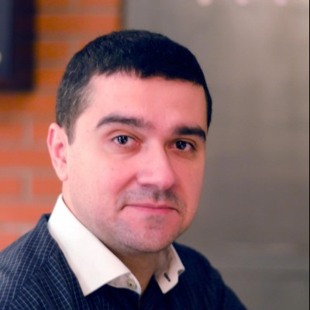


Aleksandar Stoisavljevic
Levi9 IT Services
@staleksit
linkedin.com/in/astoisavljevic

Slide 3
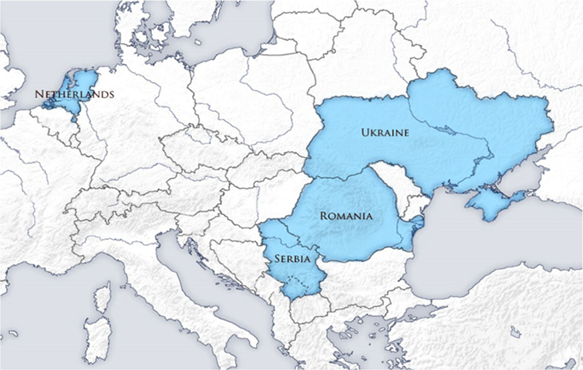
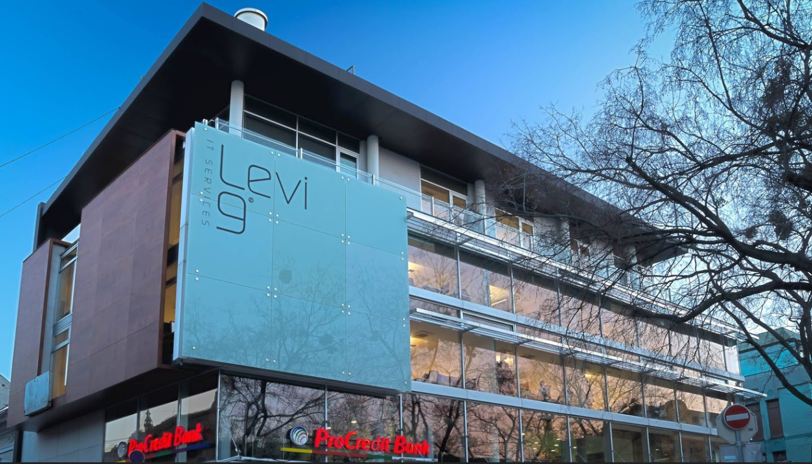
Head Office/Amsterdam
Serbia/Novi Sad
Serbia/Zrenjanin
Serbia/Belgrade
Romania/Iasi
Ukraine/Kiev
Ukraine/Lviv

Slide 4


Slide 5
September 16th 2016.
*or just few days ago

Slide 6


Slide 7


Slide 8

What kind of
servers?
How many
servers?
Which operating system patch level?
How about security on
servers?

Slide 9

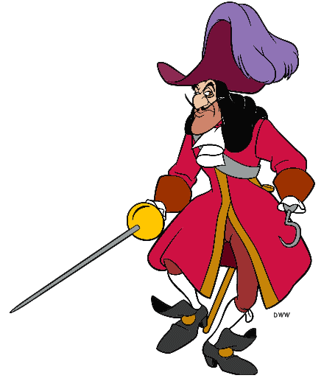



Slide 10
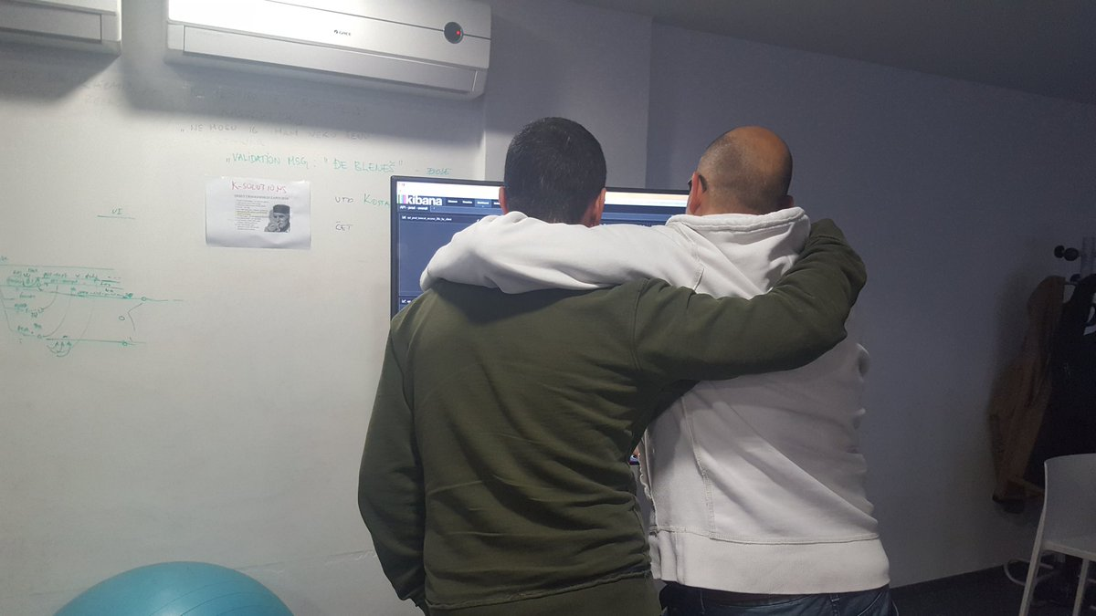


Slide 11
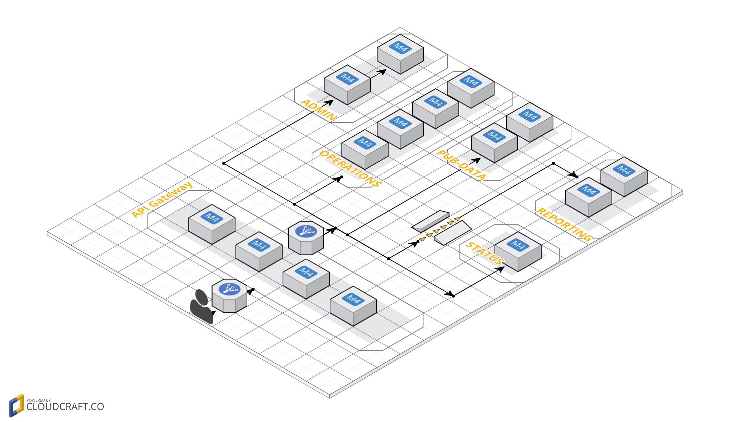
Deployment diagram

Slide 12


I asked you to go to
the Moon for me
You went to POLARIS
Chris Goodier – Chief Product Owner at ImproveDigital

Slide 13
POLARIS API
new star is born

Slide 14

Moral of THE STORY
How many servers should I budget for?
How will I keep my server OS patched?
Which OS should my servers run?
How will new code be deployed to my servers?
When should I decide to scale up my servers?
How many users create too much load for my servers?
How much remaining capacity do my servers have?
How I can control access from my servers?
Which users should have access to my servers?
What size servers are right for my budget?
How can I detect if server has been compromised?

Slide 15
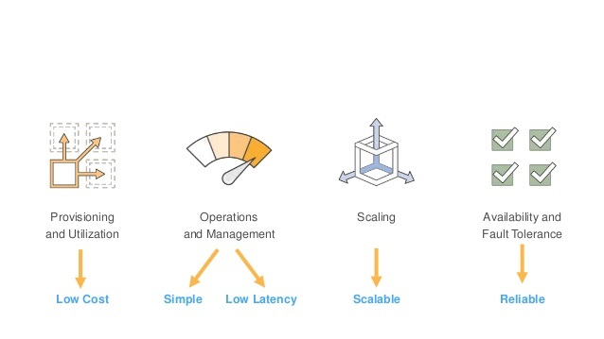
ASK BUSINESS

Slide 16
What is serverless?
Do not think about servers!

Slide 17
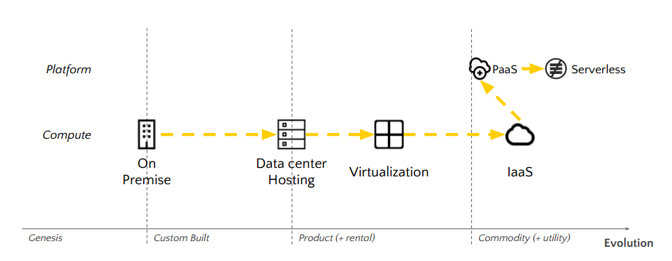
Cloud evolution

Slide 18
BaaS
FaaS

Slide 19
SERVERLESS MANIFESTO
by Dr. Tim Wagner
Functions are unit of deployment & scale
No machines, not real, nor Virtual (VM). Not even containers
Permanent storage lives elsewhere
Scaling per request
Of course, following up is economic side-effect of previous statement, you don’t pay unused stuff.
Fault tolerant
Programming language agnostic: Java, Node.js, .NET, Python

Slide 20
AWS Architectural Examples

Slide 21
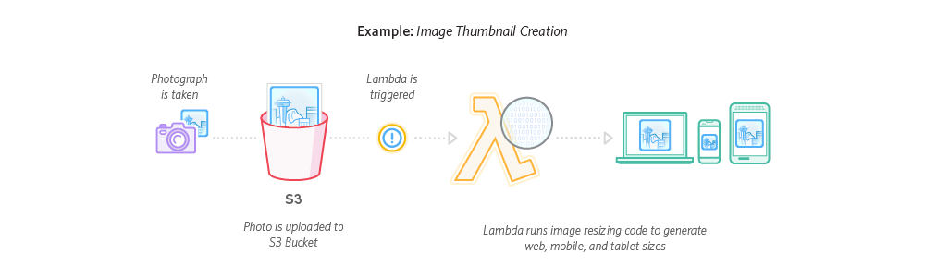
THUMBNAILING

Slide 22
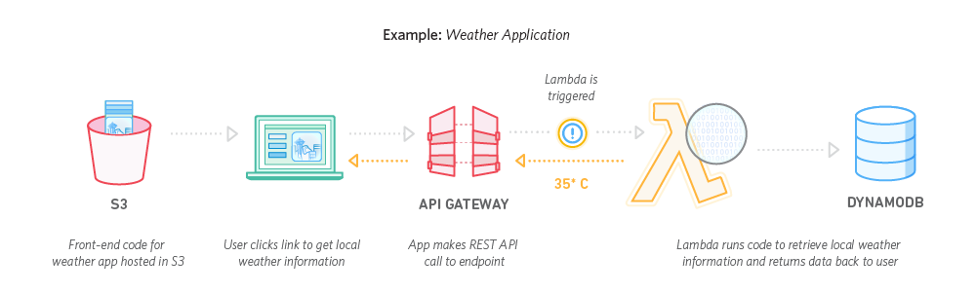
WEB APPLICATION

Slide 23
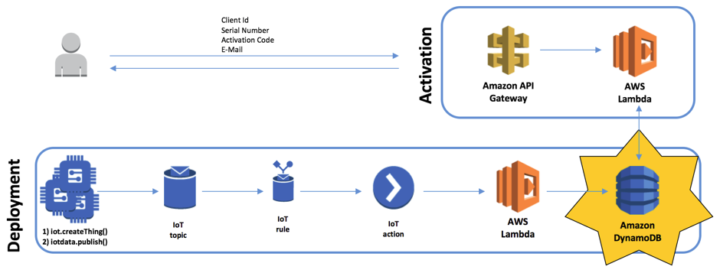
IoT

Slide 24
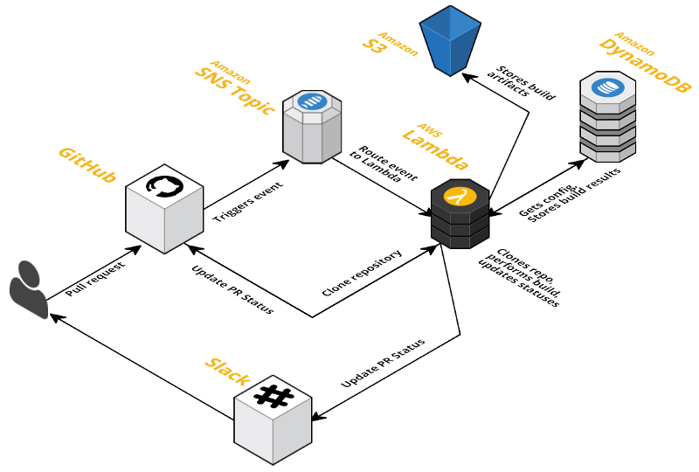
Continuous Integration

Slide 25
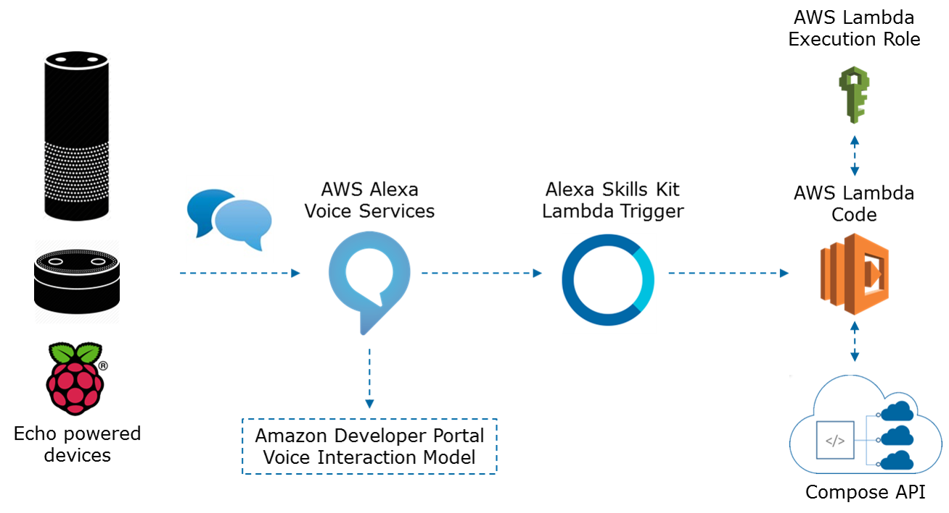
ALEXA (ECHO DOT)

Slide 26




HOW DOES IT HELP US?
BaaS - reduced development cost
FaaS - reduced operational cost (no servers, no Techops)

Slide 27
FRAMEWORKS
Serverless Framework
Apache Openwhisk (IBM)
Apex
Claudia.js
Sparta.io

Slide 28

IS IT REALY THAT SHINY?
Monitoring
Metrics
Alarms
Logging
AWS CloudWatch

Slide 29
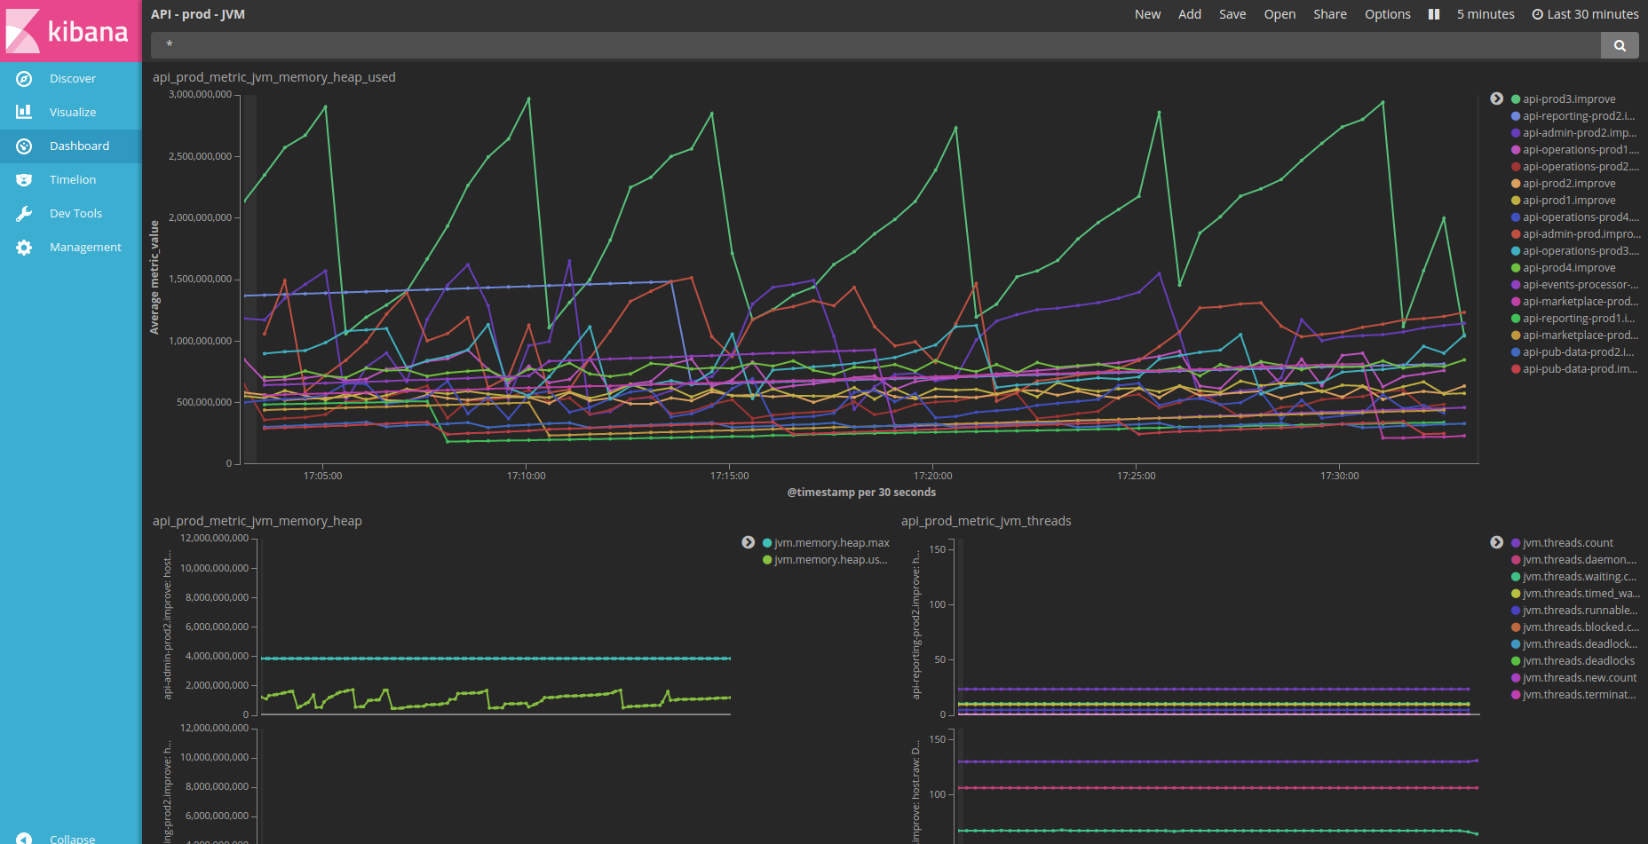
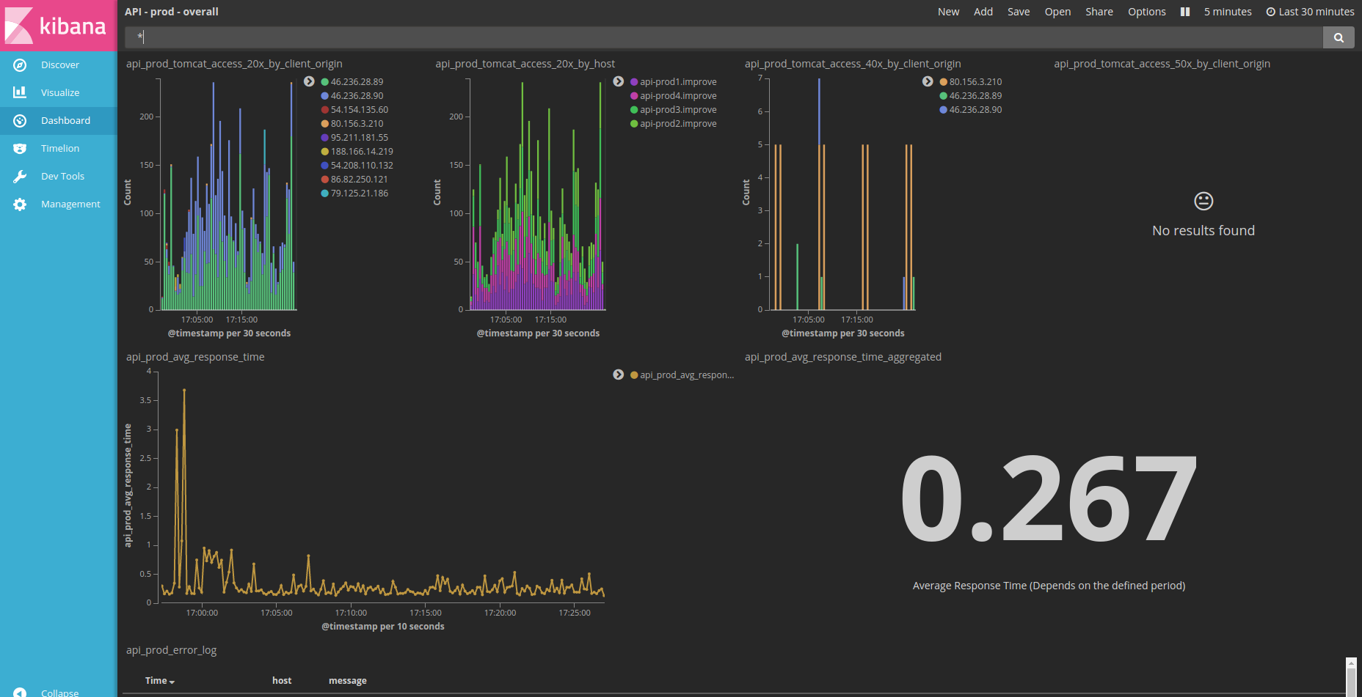
LOGS >> ES >> Kibana

Slide 30


Slide 31

One Common Goal

